Slide 1

Good Afternoon BSOL Brains !!

Slide 2
Apache Kafka Session - 1

Slide 3
RAGUNATH MUTHU
BSOL SYSTEMS PRIVATE LIMITED

Slide 4


Slide 5
Apache Kafka
Message Queueing Service ??
Streaming Platform ??

Slide 6
MESSAGE QUEUING
SERVICE
SERVICE 1
SERVICE 2
SERVICE 3
MESSAGE QUEUE MIDDLEWARE
CONSUMER1
CONSUMER 2
CONSUMER 3

Slide 7
Message queuing service ( MOM - Message Oriented Middleware ) is a type of middleware solution that allows applications and services to communicate within a computing environment.
Developer can concentrate on business implementations rather than worrying about message communications
MESSAGE QUEUING
SERVICE

Slide 8



MESSAGE QUEUING
SERVICE

Slide 9
STREAMING Platform
APPLICATION
DATA
DATABASE / FILE STORAGE

Slide 10
STREAMING Platform
APPLICATION
DATA
PROCESSED DATA
DATABASE / FILE STORAGE
DATA PROCESSING
DATA BATCH

Slide 11
STREAMING Platform
APPLICATION
DATA
DATABASE / FILE STORAGE
STREAM PROCESSING
PROCESSED DATA

Slide 12



STREAMING Platform

Slide 13
APACHE KAFKA
Distributed , fault tolerent pub/sub Message queuing system
Distributed , scalable, elastic, and fully fault-tolerant stream processing platform

Slide 14
APACHE KAFKA
Originated in LinkedIn
Open sourced in the year of 2011
Confluent was formed by people worked for Kafka in LinkedIn to work more specific on Kafka features.
Runs on cluster of one or more servers as distributed service.

Slide 15







APACHE KAFKA

Slide 16
APACHE KAFKA
THREE MAJOR FUNCTIONS OF KAFKA :
Publish-Subscribe to stream of records like other message queue systems
Stores streams of records in fault tolerant way
Processes streams of records as they occur
HE KAFKA​

Slide 17
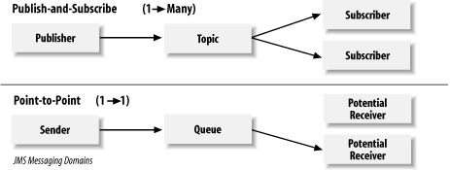
PUB / SUB DESIGN

Slide 18
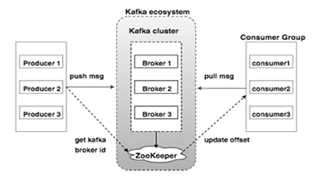
APACHE KAFKA

Slide 19
APACHE KAFKA
KAFKA BROKER :
Every node in the cluster that plays role of Kafka mediator between producer and consumer
Every broker will have a unique identification ID called broker-id
HE KAFKA​

Slide 20
APACHE KAFKA
ROLE OF ZOOKEEPER :
Helps each node to coordinate with the other nodes of the cluster
Producers and consumers are notified by the zookeeper service about the presence of new broker in Kafka system
HE KAFKA​

Slide 21
APACHE KAFKA
KAFKA PRODUCER :
Instances of an application that publishes data to the topics of their choice and responsible for choosing which record to store in which topic and which partition.
HE KAFKA​

Slide 22
APACHE KAFKA
KAFKA CONSUMER :
Only metadata saved in the consumer is offset position of partition, in other words position of that consumer in logs
Consumer controls the offset position for streaming so it can advance linearly, or it can consume records in any order it wants
HE KAFKA​

Slide 23
APACHE KAFKA
KAFKA CONSUMER GROUP :
Consumers can join a group by using the same group id
Each partition is consumed by exactly one consumer in a group at once, but single consumer can read data from multiple partition.
HE KAFKA​

Slide 24
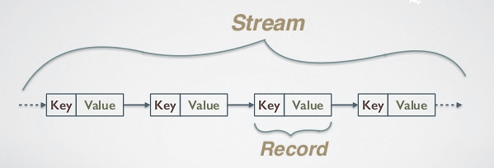
APACHE KAFKA
KAFKA RECORD :
It’s a key-value pair
Each record consists a key, value and timestamp
HE KAFKA​

Slide 25
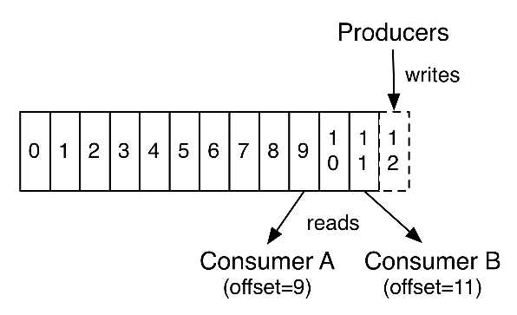
APACHE KAFKA
KAFKA OFFSET:
Unique identification as index for the records stored in partition like array
Order will be as per the broker receives the record message
HE KAFKA​

Slide 26
APACHE KAFKA
KAFKA TOPIC :
Unique name for a data stream stored in brokers
Topics can simply be termed as a “Category” to store a record of data that can be defined by the user
HE KAFKA​

Slide 27
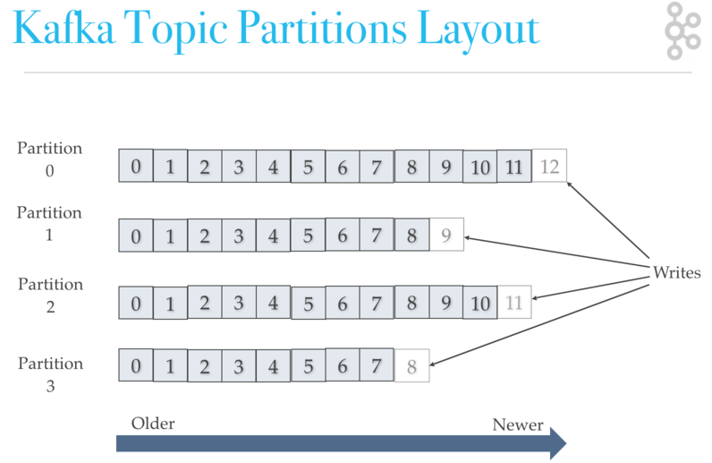
APACHE KAFKA
KAFKA TOPIC :
HE KAFKA​

Slide 28
APACHE KAFKA
KAFKA TOPIC PARTITION :
Every Topic must have at least one partition
Partition here is nothing but splitting a single topic into multiple parallelized parts
HE KAFKA​

Slide 29
APACHE KAFKA
KAFKA TOPIC PARTITION LEADER AND FOLLOWERS :
PARTITION LEADER:
Its partition leader’s responsibility to get the data from producer, stores it and sends back the acknowledgement
Its leader’s responsibility to send back the requested data to the consumer
PARTITION FOLLOWER:
Don’t talk to producer or consumer but with the leader
If the leader goes down, then Kafka takes care of making any one follower as the leader
HE KAFKA​

Slide 30
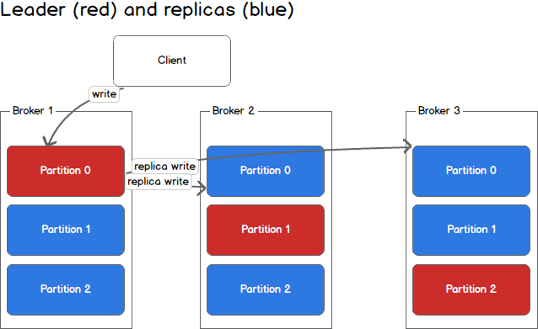
APACHE KAFKA

Slide 31
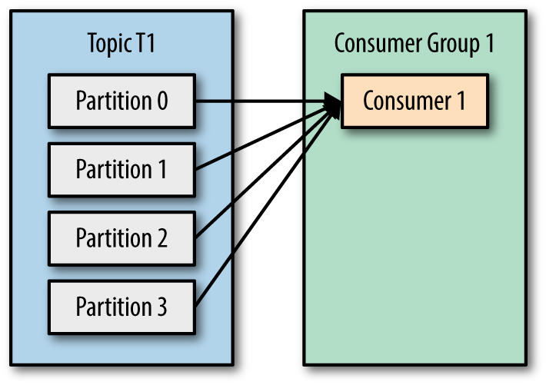
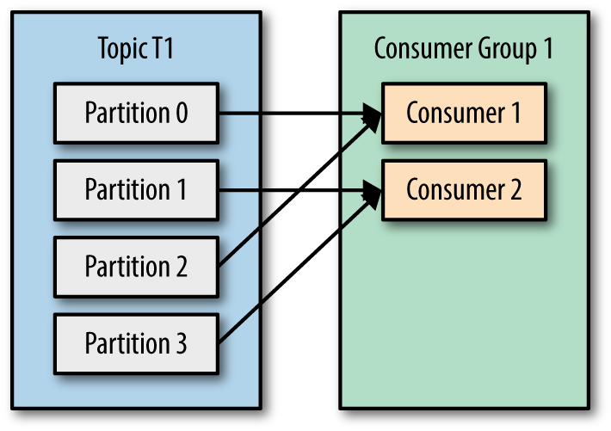
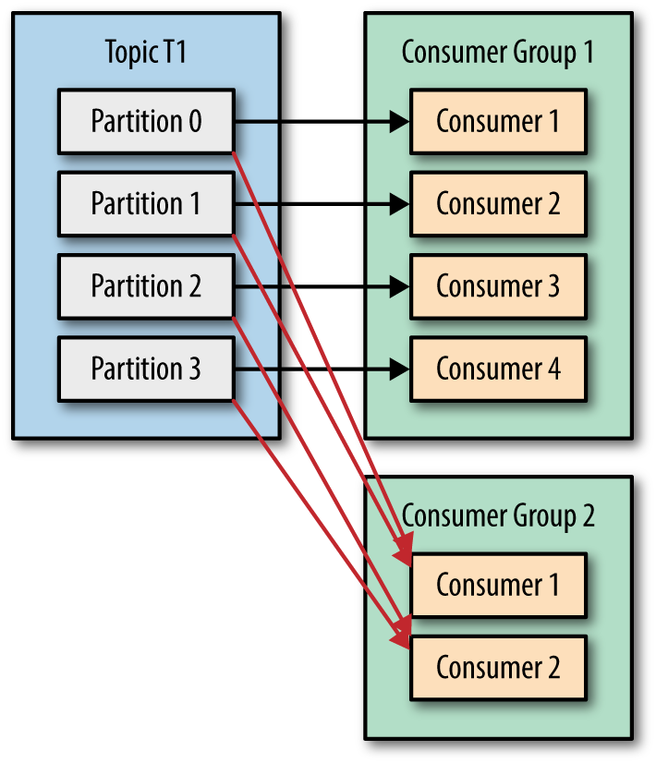
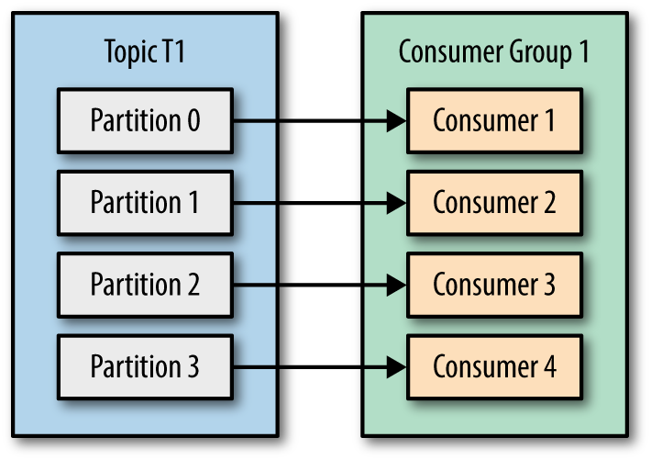
APACHE KAFKA

Slide 32
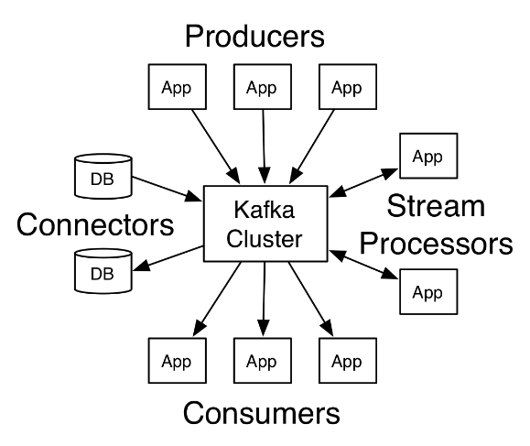
APACHE KAFKA
Producer API
Consumer API
Streams API
Connector API
HE KAFKA​

Slide 33

APACHE KAFKA

Slide 34

APACHE KAFKA

Slide 35

APACHE KAFKA

